Slide 1
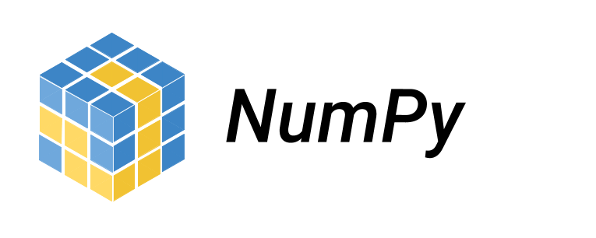
NumPy is a Python library that provides a simple yet powerful data structure: the n-dimensional array. This is the foundation on which almost all the power of Python’s data science toolkit is built, and learning NumPy is the first step on any Python data scientist’s journey. This tutorial will provide you with the knowledge you need to use NumPy and the higher-level libraries that rely on it.

Slide 2
Choosing NumPy: The Benefits
More speed: NumPy uses algorithms written in C that complete in nanoseconds rather than seconds.
Fewer loops: NumPy helps you to reduce loops and keep from getting tangled up in iteration indices.
Clearer code: Without loops, your code will look more like the equations you’re trying to calculate.
Better quality: There are thousands of contributors working to keep NumPy fast, friendly, and bug free.

Slide 3
There are several important differences between NumPy arrays and the standard Python sequences:
NumPy arrays have a fixed size at creation, unlike Python lists (which can grow dynamically). Changing the size of an ndarray will create a new array and delete the original.
The elements in a NumPy array are all required to be of the same data type, and thus will be the same size in memory. The exception: one can have arrays of (Python, including NumPy) objects, thereby allowing for arrays of different sized elements.
NumPy arrays facilitate advanced mathematical and other types of operations on large numbers of data. Typically, such operations are executed more efficiently and with less code than is possible using Python’s built-in sequences.
A growing plethora of scientific and mathematical Python-based packages are using NumPy arrays; though these typically support Python-sequence input, they convert such input to NumPy arrays prior to processing, and they often output NumPy arrays. In other words, in order to efficiently use much (perhaps even most) of today’s scientific/mathematical Python-based software, just knowing how to use Python’s built-in sequence types is insufficient - one also needs to know how to use NumPy arrays.

Slide 4
For Examples:->
If You Want To Multiply or Add Two Or More Arrays, You Need Not To Run Any Loop….
Using Numpy You Can Just Multiply Or Add Them Like Any Other Scalar Entity….
C=A+B
C=A-B
C=A*B
C=A/B

Slide 5
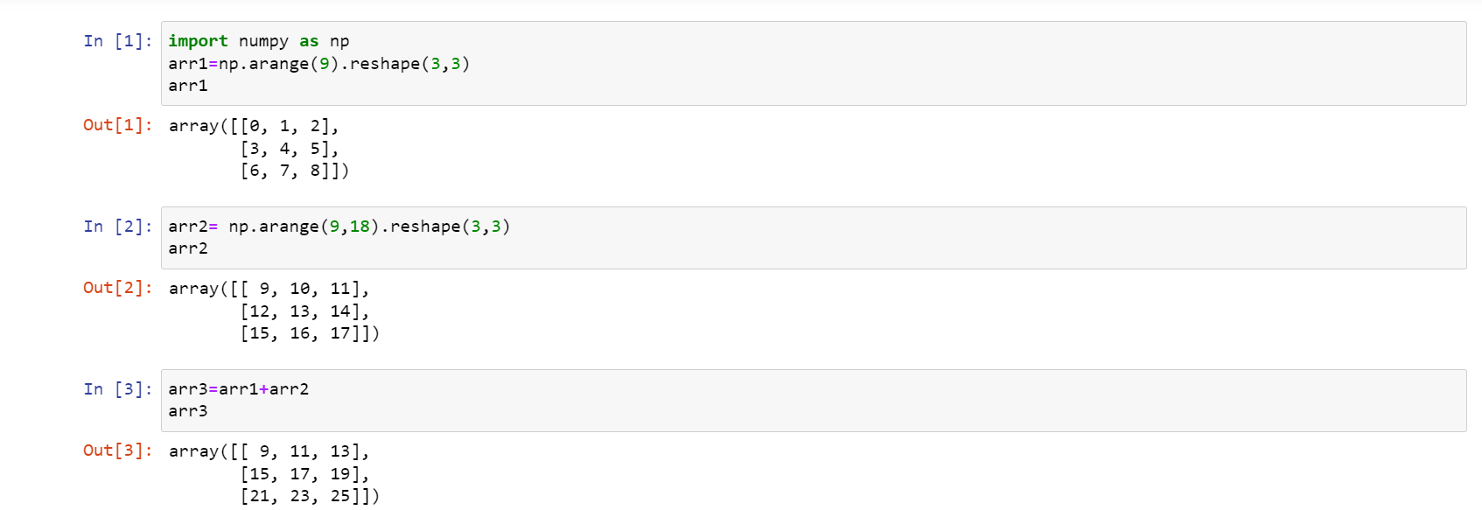
Example :-> Addition

Slide 6
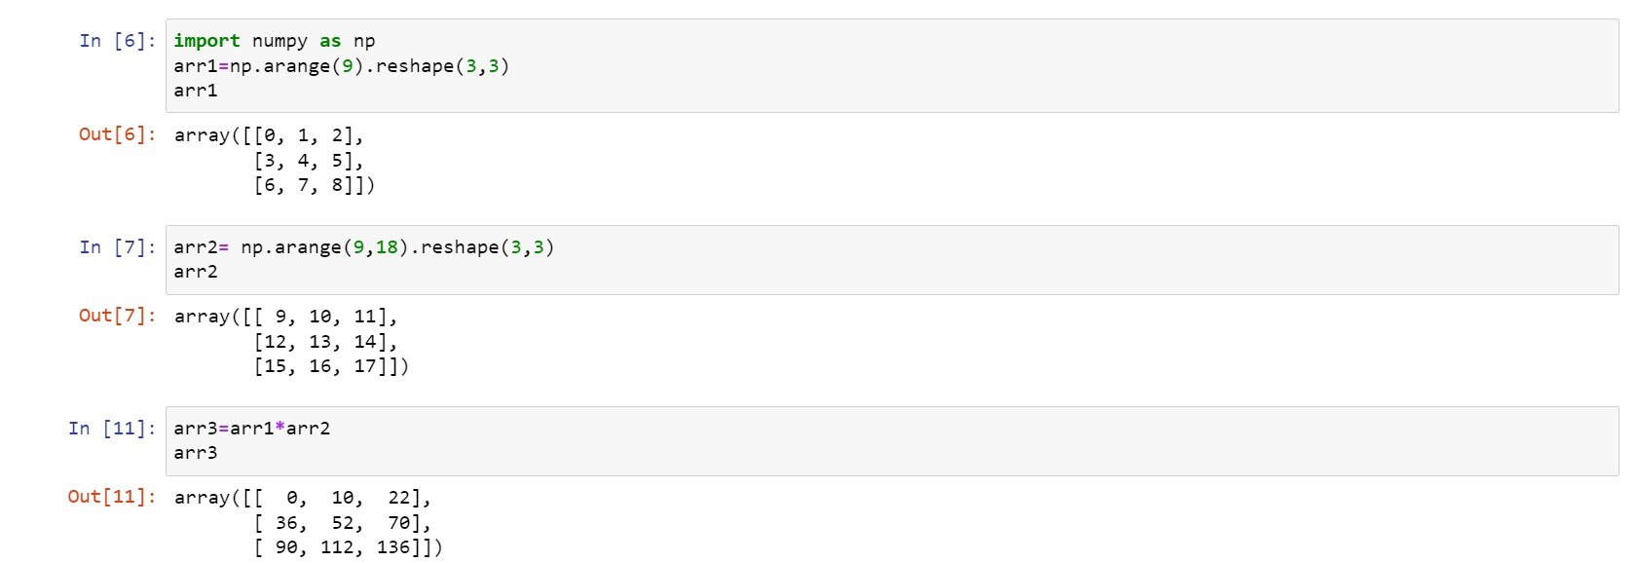
Example:->Multiplication

Slide 7

Created by:
Umakant Yadav
Raghav Malhotra

